Slide 1
Lecture No 1: Welcome To C#
Muhammad Siddique

Slide 2
Outline
Use the Microsoft Visual Studio 2017 programming environment.
Create a C# console application.
Explain the purpose of namespaces.
Create a simple graphical C# application. (Lab Work)

Slide 3
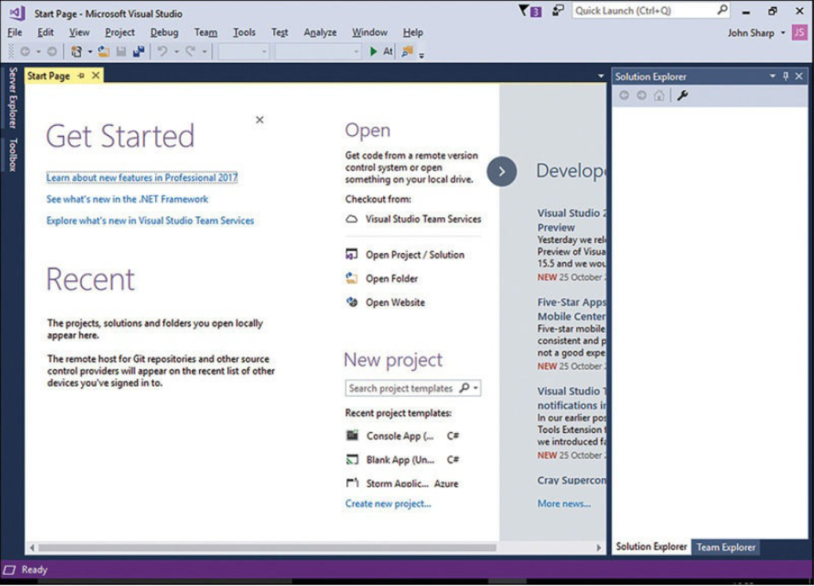
Create a Console Application in Visual Studio 2017
On the Windows taskbar, click Start, type Visual Studio 2017, and then press Enter. Alternatively, you can click the Visual Studio 2017 icon on the Start menu.
Visual Studio 2017 starts and displays the Start page, similar to the following. (Your Start page might be different, depending on the edition of Visual Studio 2017 you are using.)

Slide 4
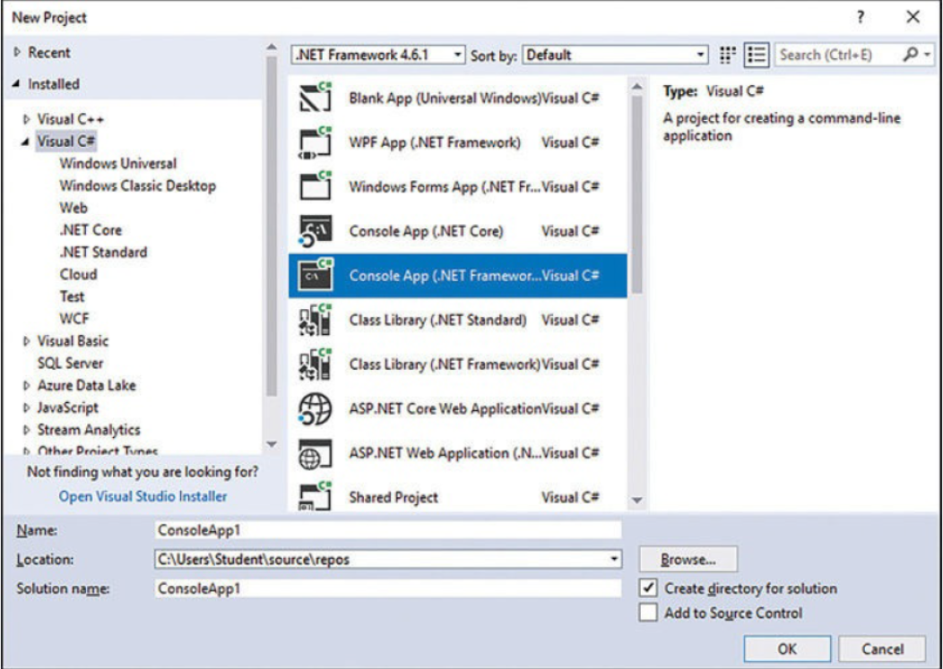
Create a Console Application in Visual Studio 2017 (Continue…
On the File menu, point to New, and then click Project.
The New Project dialog box opens. This dialog box lists the templates that you can use as a starting point for building an application.
In the left pane, expand the Installed node and then click Visual C#. In the middle pane, verify that the combo box at the top of the pane displays .NET Framework 4.6.1, and then click Console App (.NET Framework).

Slide 5
Create a Console Application in Visual Studio 2017 (Continue…
In the Location box, type C:\Users\YourName\Documents\Microsoft Press\VCSBS\. Replace the text YourName in this path with your Windows username.
In the Name box, type TestHello (type over the existing name, ConsoleApplication1).
In the Name box, type TestHello (type over the existing name, ConsoleApplication1).
Ensure that the Create Directory For Solution check box is selected and that the Add To Source Control check box is clear, and then click OK.

Slide 6
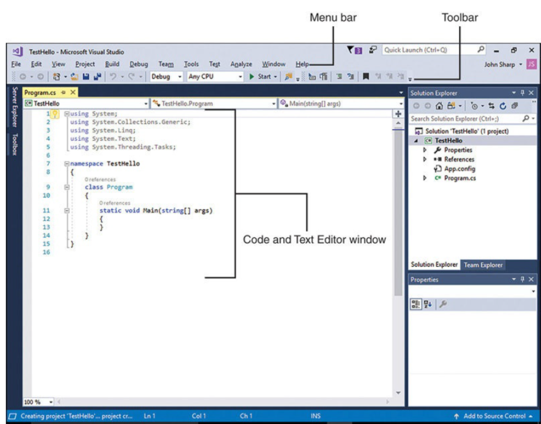
Create a Console Application in Visual Studio 2017 (Continue…
Visual Studio creates the project by using the Console Application template.
Visual Studio then displays the starter code for the project, like shown in fig.

Slide 7
Create a Console Application in Visual Studio 2017 (Continue…
The menu bar at the top of the screen provides access to the features you’ll use in the programming environment.
You can use the keyboard or mouse to access the menus and commands, exactly as you can in all Windows-based programs.
The toolbar is located beneath the menu bar. It provides button shortcuts to run the most frequently used commands.
The Code and Text Editor window, occupying the main part of the screen, displays the contents of source files.
In a multi-file project, when you edit more than one file, each source file has its own tab labeled with the name of the source file.
You can click the tab to bring the named source file to the foreground in the Code and Text Editor window.

Slide 8
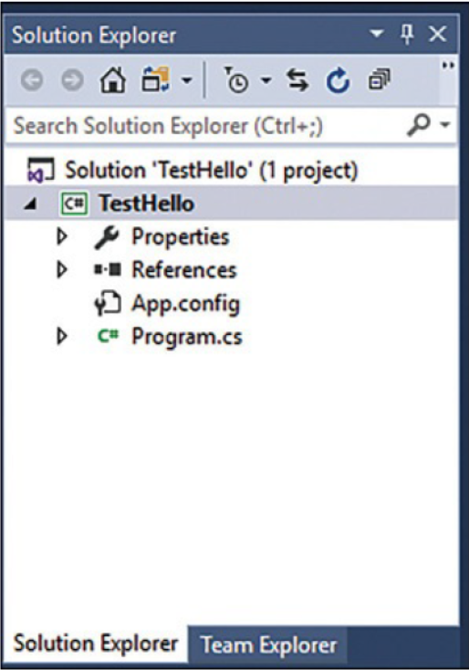
Create a Console Application in Visual Studio 2017 (Continue…
The Solution Explorer pane appears on the right side of the IDE, adjacent to the Code and Text Editor window:
Solution Explorer displays the names of the files associated with the project, among other items.
You can also double-click a file name in Solution Explorer to bring that source file to the foreground in the Code and Text Editor window.

Slide 9
Features of “Solution Explorer”
Following are the files listed in Solution Explorer, which Visual Studio 2017 has created as part of your project:
Solution ‘ TestHello ’.
TestHello.
Properties.
References.
App.config.
Program.cs.

Slide 10
Features of “Solution Explorer” (Continue…)
Solution ‘TestHello’
This is the top-level solution file.
Each application contains a single solution file.
A solution can contain one or more projects, and Visual Studio 2017 creates the solution file to help organize these projects.
If you use File Explorer to look at your Documents\MicrosoftPress\VCSBS\Chapter 1\TestHello folder, you’ll see that the actual name of this file is TestHello.sln.

Slide 11
Features of “Solution Explorer” (Continue…)
TestHello
This is the C# project file.
Each project file references one or more files containing the source code and other artifacts for the project, such as graphics images.
You must write all the source code in a single project in the same programming language.
In File Explorer, this file is actually called TestHello.csproj, and it is stored in the \Microsoft Press\VCSBS\Chapter 1\ TestHello\TestHello folder in your Documents folder.

Slide 12
Features of “Solution Explorer” (Continue…)
Properties
This is a folder in the TestHello project.
If you expand it (click the arrow next to Properties), you will see that it contains a file called AssemblyInfo.cs.
AssemblyInfo.cs is a special file that you can use to add attributes to a program, such as the name of the author, the date the program was written, and so on.
You can specify additional attributes to modify the way in which the program runs.

Slide 13
Features of “Solution Explorer” (Continue…)
References (1/2)
This folder contains references to libraries of compiled code that your application can use.
When your C# code is compiled, it is converted into a library and given a unique name. In the Microsoft .NET Framework, these libraries are called assemblies.
Developers use assemblies to package useful functionality that they have written so that they can distribute it to other developers who might want to use these features in their own applications.

Slide 14
Features of “Solution Explorer” (Continue…)
References (2/2)
If you expand the References folder, you will see the default set of references that Visual Studio 2017 adds to your project.
These assemblies provide access to many of the commonly used features of the .NET Framework and are provided by Microsoft with Visual Studio 2017.

Slide 15
Features of “Solution Explorer” (Continue…)
App.config
This is the application configuration file.
It is optional, and it might not always be present.
You can specify settings that your application uses at run time to modify its behavior, such as the version of the .NET Framework to use to run the application.

Slide 16
Features of “Solution Explorer” (Continue…)
Program.cs
This is a C# source file, and it is displayed in the Code and Text Editor window when the project is first created.
You will write your code for the console application in this file.
It also contains some code that Visual Studio 2017 provides automatically, which you will examine shortly.

Slide 17
Write Your First Program
The Program.cs file defines a class called Program that contains a method called Main.
In C#, all executable code must be defined within a method, and all methods must belong to a class or a struct.
The Main method designates the program’s entry point.
This method should be defined in the manner specified in the Program class as a static method; otherwise, the .NET Framework might not recognize it as the starting point for your application when you run it.

Slide 18
Write Code by Using Microsoft IntelliSense
In the Code and Text Editor window displaying the Program.cs file, place the cursor in the Main method, immediately after the opening curly brace ( { ), and then press Enter to create a new line.
On the new line, type the word Console; this is the name of another class provided by the assemblies referenced by your application. It provides methods for displaying messages in the console window and reading input from the keyboard.
As you type the letter C at the start of the word Console, an IntelliSense list appears.
This list contains all of the C# keywords and data types that are valid in this context.

Slide 19
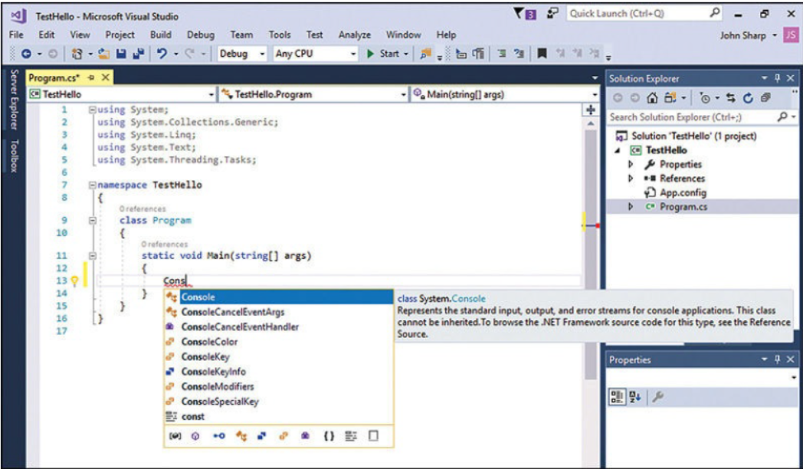
Write Code by Using Microsoft IntelliSense

Slide 20
Write Code by Using Microsoft IntelliSense
Type a period immediately following Console
Another IntelliSense list appears, displaying the methods, properties, and fields of the Console class.
Scroll down through the list, select WriteLine, and then press Enter.
Alternatively, you can continue typing the characters W, r, i, t, e, L until WriteLine is selected, and then press Enter.
The IntelliSense list closes, and the word WriteLine is added to the source file. Main should now look like this: → static void Main(string [ ] args) {
Console.WriteLine
}

Slide 21
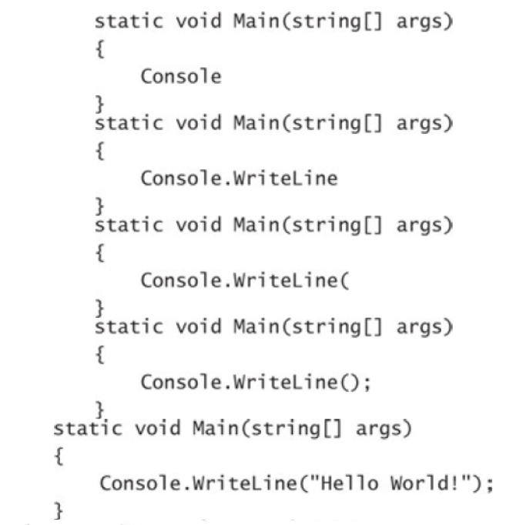
Write Code by Using Microsoft IntelliSense
5. Type ( and another IntelliSense tip will appear).
This tip displays the parameters that the WriteLine method can take. In fact, WriteLine is an overloaded method, meaning that the Console class contains more than one method named WriteLine.
It provides 19 different versions of this method. You can use each version of the WriteLine method to output different types of data.

Slide 22
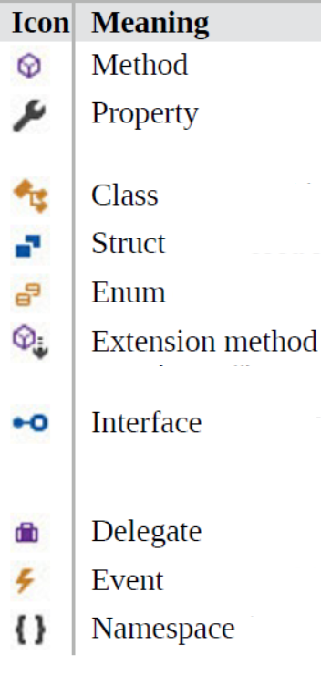
IntelliSense Icons
When you type a period ( . ) after the name of a class, IntelliSense displays the name of every member of that class.
To the left of each member name is an icon that depicts the type of member.
You will also see other IntelliSense icons appear as you type code in different contexts.
Common icons and their types are shown in fig.

Slide 23
Commenting Format
For single line use // ……singl text line.…….
For multiple lines use /* ………………..multiple line………… */
For one whole document or page use /** document */

Slide 24
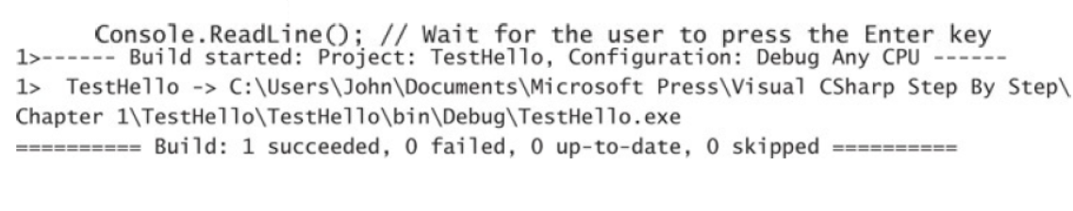
Build and run the console application
On the build menu, Click Build solution.
This action compiles the C# code, resulting in a program that you can run.
The Output window appears below the Code and Text Editor window.
In the Output window, you should see messages similar to the following, indicating how the program is being compiled:

Slide 25
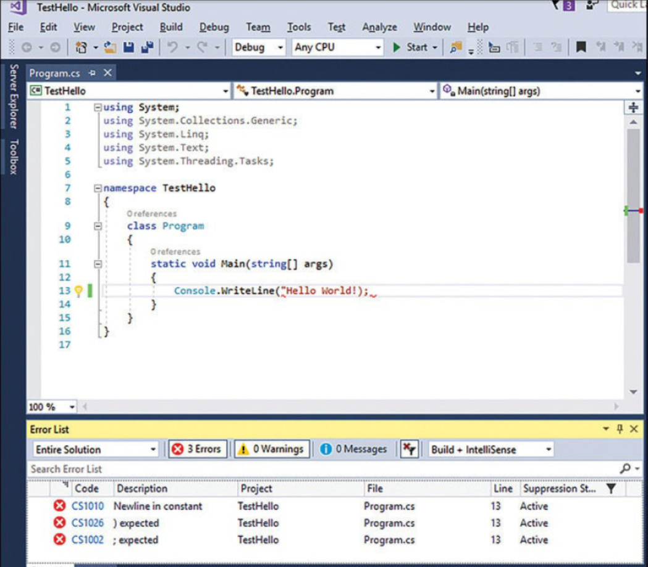
Build & Run the Console Application (Continue…)
If you have made any mistakes, they will be reported in the Error List window.
The following image shows what happens if you forget to type the closing quotation marks after the text Hello World in the WriteLine statement.
Notice that a single mistake can sometimes cause multiple compiler errors.
If you have followed the previous instructions carefully, there should be no errors or warnings, and the program should build successfully.

Slide 26
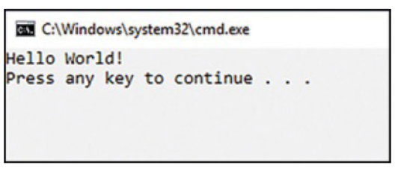
Build & Run the Console Application (Continue…)
2. On the Debug menu, click Start Without Debugging.
A command window opens, and the program runs.
The message “Hello World!” appears.
The program now waits for you to press any key, as shown in the following graphic.

Slide 27
Build & Run the Console Application (Continue…)
3. Ensure that the command window displaying the program’s output has the focus (meaning that it’s the window that’s currently active), and then press Enter.
The command window closes, and you return to the Visual Studio 2017 programming environment.
In Solution Explorer, click the TestHello project (not the solution), and then, on the Solution Explorer toolbar, click the Show All Files button.
Be aware that you might need to click the double-arrow button on the right edge of the Solution Explorer toolbar to make this button appear.

Slide 28
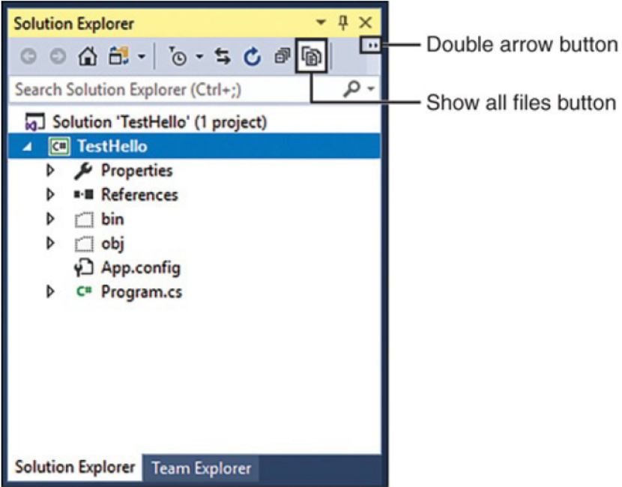
Build & Run the Console Application (Continue…)
Entries named bin and obj appear above the Program.cs file.
These entries correspond directly to folders named bin and obj in the project folder (Microsoft Press\VCSBS\Chapter 1\TestHello\TestHello).
Visual Studio creates these folders when you build your application; they contain the executable version of the program together with some other files used to build and debug the application.

Slide 29
Using Namespace (Introduction)
A namespace is used to organize your code by the collection of classes, structs, enums and delegates.
They are used to access code from .NET frame work, because .NET frame has so many classes, interfaces, structs etc.
e.g. Console.WriteLine();
If we don’t use namespace then we have to use FQN (Fully Qualified Name) to use that particular classes, interfaces and structs.
e.g. System.Console.WriteLine();
In java they are available with the name called Packages.

Slide 30
How Namespace Developed
Small programs can soon grow into much bigger programs.
As a program grows, two issues arise.
First, it is harder to understand and maintain big programs than it is to understand and maintain smaller ones.
Second, more code usually means more classes, with more methods, requiring you to keep track of more names.
As the number of names increases, project build failing because two or more names clash.
For example, two classes can be created with same name.

Slide 31
Using Namespace (History)
The situation becomes more complicated when a program written by outsource developers who have also used a variety of own names.
In the past, programmers tried to solve the name-clashing problem by prefixing names with some sort of qualifier (or set of qualifiers).
Using prefixes as qualifiers is not a good solution because it’s not scalable.
Names become longer, you spend less time writing software and more time typing (there is a difference), and you spend too much time reading and rereading incomprehensibly long names.

Slide 32
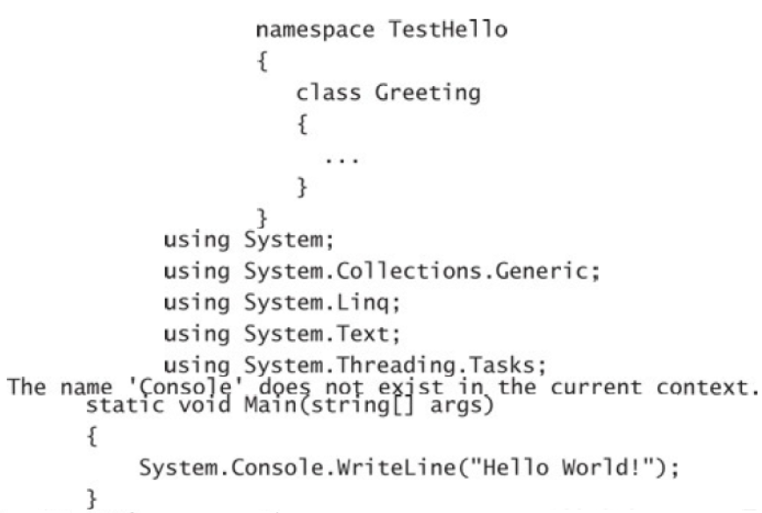
Using Namespace (as Solution)
Namespaces help solve this problem by creating a container for items such as classes.
Two classes with the same name will not be confused with each other if they live in different namespaces.
You can create a class named Greeting inside the namespace named TestHello by using the namespace keyword like this as shown in fig.

Slide 33
Using Namespace (as Solution) Continue…
You can then refer to the Greeting class as TestHello.Greeting in your programs.
If another developer also creates a Greeting class in a different namespace, such as NewNamespace, and you install the assembly that contains this class on your computer, your programs will still work as expected because they are using your TestHello.Greeting class.
If you want to refer to the other developer’s Greeting class, you must specify it as NewNamespace.Greeting.
It is good practice to define all your classes in namespaces, and the Visual Studio 2017 environment follows this recommendation by using the name of your project as the top-level namespace.

Slide 34
Using Namespace (as Solution) Continue…
The .NET Framework class library also adheres to this recommendation; every class in the .NET Framework lives within a namespace.
For example, the Console class lives within the System namespace.
This means that its full name is actually System.Console.
If you had to write the full name of a class every time you used it, the situation would be no better than prefixing qualifiers or even just naming the class with some globally unique name such as SystemConsole.
Fortunately, you can solve this problem with a using directive in your programs.

Slide 35
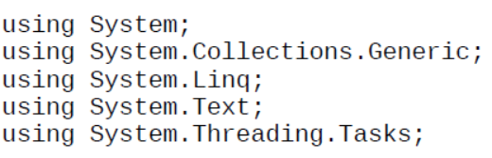
Using Namespace (as Solution) Continue…
If you return to the TestHello program in Visual Studio 2017 and look at the file Program.cs in the Code and Text Editor window, you will notice the following lines at the top of the file:
These lines are using directives. A using directive brings a namespace into scope.
In the subsequent code in the same file, you no longer need to explicitly qualify objects with the namespace to which they belong.
The five namespaces shown contain classes that are used so often that Visual Studio 2017 automatically adds these using directives every time you create a new project.

